Slide 1

Modeling & Predicting Lower Back Pain
Jessica Pals | Entity Academy

Slide 2



My Personal Background
Bachelor of Science Psychology Graduate from uMass Amherst, field research with Harvard University.
Transcribed audio data from product development research when Amazon was developing their “Alexa” technology.
Broad range of work experience from research, transcription, business operations analysis, store management and customer service.

Slide 3
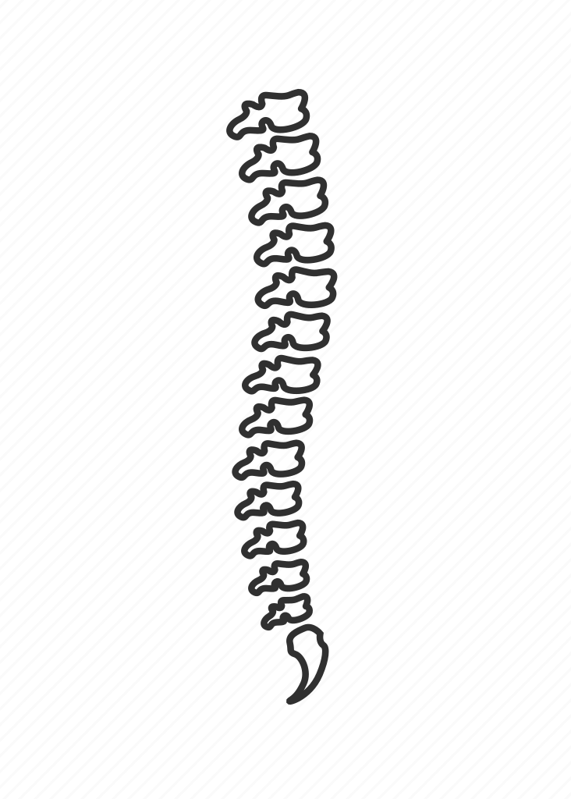
Project Introduction
- Back pain is a topic that most people can understand; most experience it at some point in their lives. One google search will tell you that chronic back pain is a major health problem. For many, chronic back pain is so severe that it gets in the way of daily life and makes necessary functions like work difficult.
- Advancements in computer technology such as machine learning create new opportunities for therapy and pain relief.

Slide 4
Project Introduction
How can machine learning and prediction technology help people with their lower back pain?
- Predicting when someone is getting close to experiencing abnormal pain can help them prevent issues from arising, as well as aid a physician in prescribing therapy early on before issues that have just started to cause pain become worse.
- Prediction can help a physician understand a patient’s pain who may not be able to communicate it well (nonverbal, etc).
- Machine learning could be capable of helping to classify how bad a person’s pain might be.

Slide 5
Project Introduction
Why is this helpful?
- Preventing someone’s pain or catching it before it becomes worse prevents people from missing out on necessary life functions such as work.
- It is extremely valuable to get as much relevant information about a patient as possible, this technology would allow to have that information from someone who is not able to communicate it well or at all.
- With growing drug abuse, many physicians are hesitant to believe the pain a patient experiences if they “don’t look like they are in pain”. Additional information like this gives confirmation that the patient is being truthful and allows the patient to be trusted and get the care they need.

Slide 6

Background Information

Slide 7
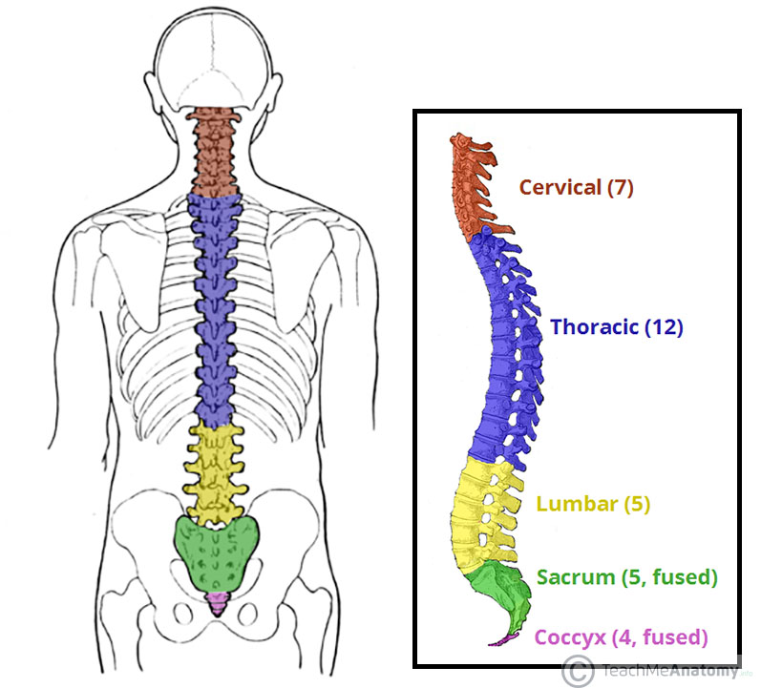

Parts of the Spine
Cervical Spine: In red, makes up your neck.
Thoracic Spine: In blue, the main part of your back.
Lumbar Spine: In yellow, makes up your lower back.
Sacral Spine/Sacrum: In green, the part of the spine that goes through the pelvis/hips.
Coccyx: In pink, also known as the tailbone.
Pelvis/Hips

Slide 8
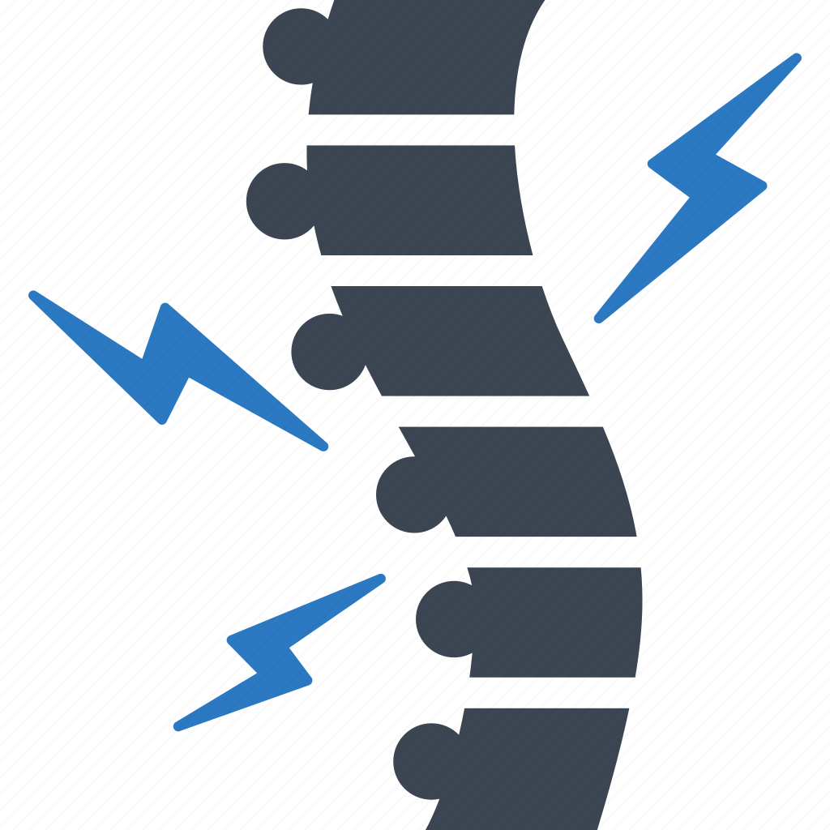
Conditions of the Spine

Slide 9
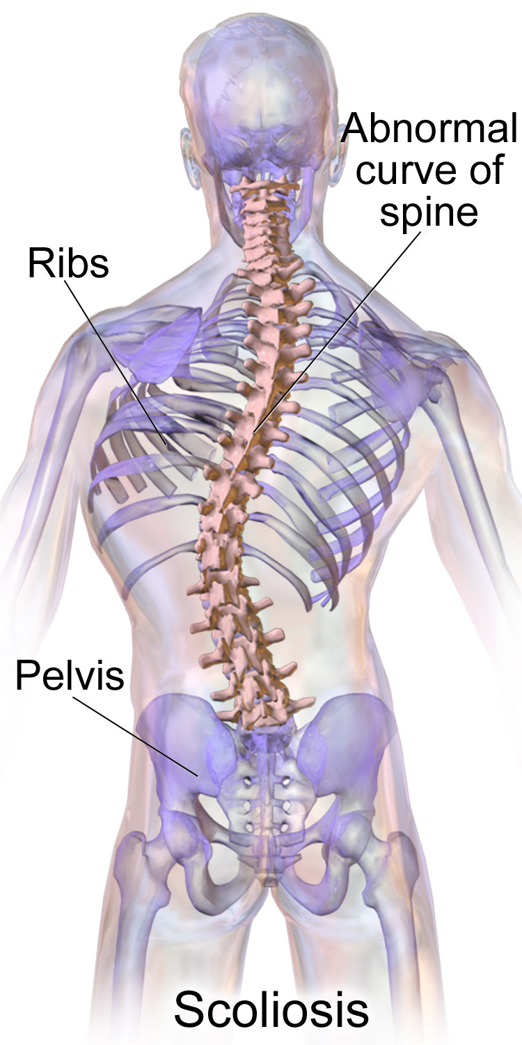
Scoliosis
Sideways curvature of the spine

Slide 10
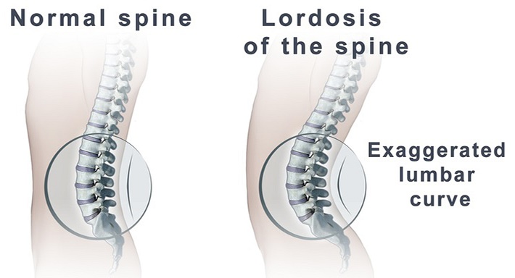
Lumbar Lordosis
Arch in the lumbar spine

Slide 11
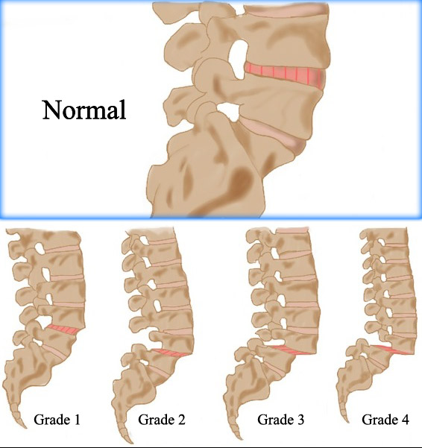
Spondylolisthesis
The lower vertebrae (bones that make up the spine) slip apart from one another.
Has degrees of severity and can be notably more serious/painful than scoliosis and lumbar lordosis.

Slide 12
About the Data
- The data consists of 12 attributes of the spine (measurements taken from an x-ray of a patient) and a classifier of whether that person experiences abnormal pain or not (reported by the patient).
- No demographic data for each patient, just measurements of the attributes.
- Sample Size = 310
https://www.kaggle.com/datasets/sammy123/lower-back-pain-symptoms-dataset

Slide 13
About the Data
Attributes
Pelvic Incidence
Pelvic Tilt
Pelvic Radius
Sacral Slope
Pelvic Slope
Thoracic Slope
Lumbar Lordosis
Degree of Spondylolisthesis
Direct Tilt
Cervical Tilt
Sacrum Angle
Scoliosis Slope

Slide 14
Methods
Dataset was found and downloaded from Kaggle.
Data Cleaning Done in Python:
- Unnecessary column removed.
- Columns renamed as attributes.
- Pain recoded from Abnormal/Normal to 0/1.

Slide 15



Methods
Backwards Regression Analysis in R
Machine Learning in Python
Visualization in Python and Tableau

Slide 16

Evaluation Questions & Results

Slide 17
Which attributes have the greatest impact on lower back pain?
To answer this question, a backwards elimination stepwise regression was performed on the data.
This looked at each attribute and narrowed them down to a list of the attributes the regression model determined having the most influence over a person’s pain status: normal vs. abnormal.

Slide 18
Which attributes have the greatest impact on lower back pain?
Most Influential Attributes on Lower Back Pain:
Pelvic Incidence
Pelvic Radius
Pelvic Tilt
Degree of Spondylolisthesis
Lumbar Lordosis Angle
Pelvic Radius, Pelvic Tilt, and Degree of Spondylolisthesis have the most significant influence on whether some experiences lower back pain.

Slide 19
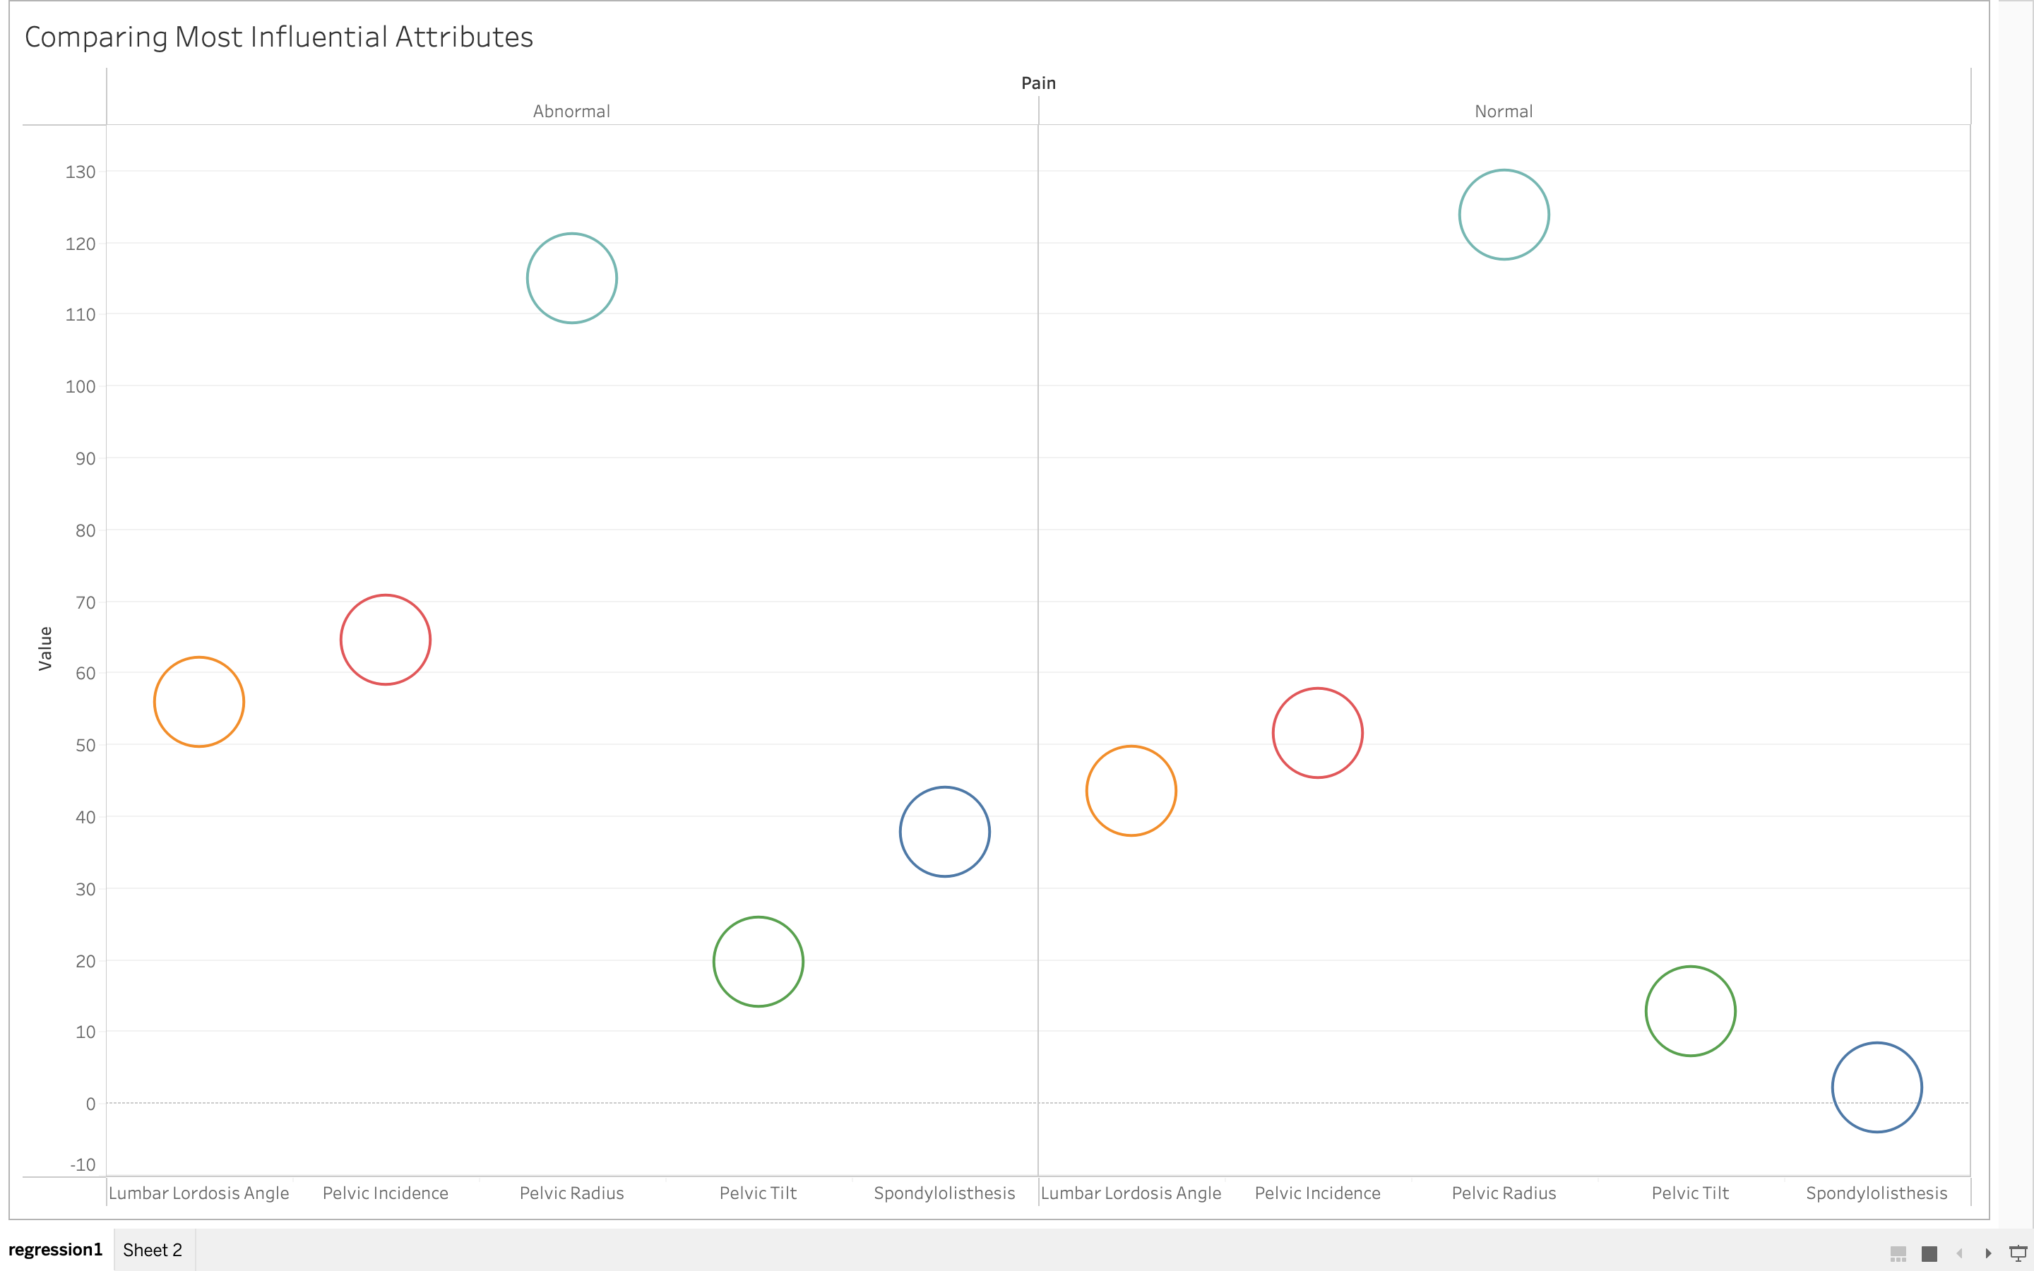

Slide 20
From a quick glance, you can see that the biggest difference between between normal and abnormal pain was in the degree of spondylolisthesis.
This makes sense, as spondylolisthesis is the most severe spine condition covered in the dataset and generally can experience more pain than scoliosis and lumbar lordosis.

Slide 21
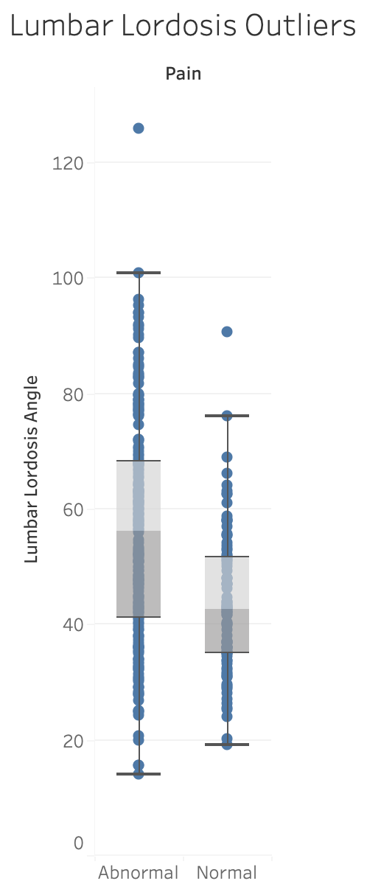
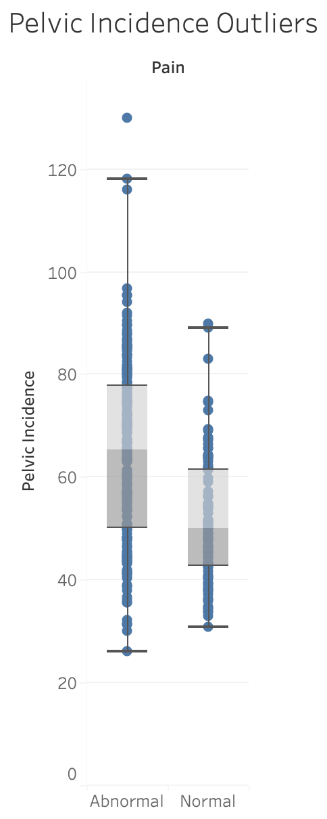
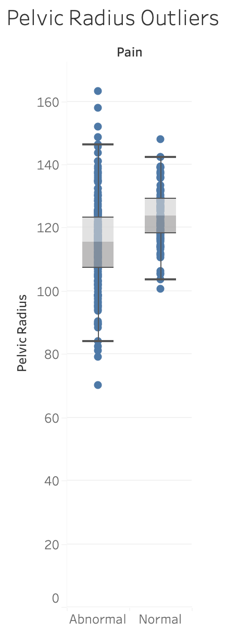
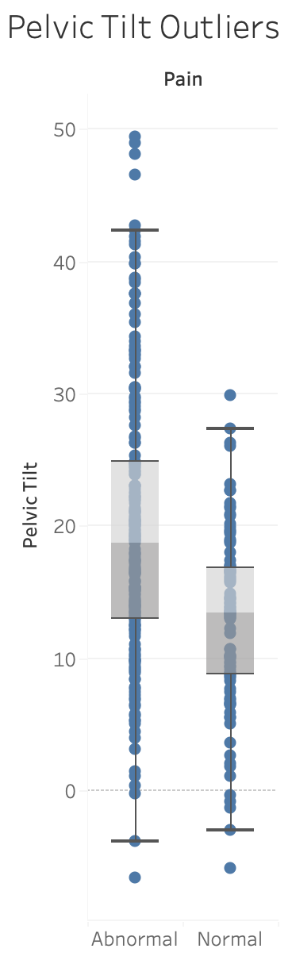
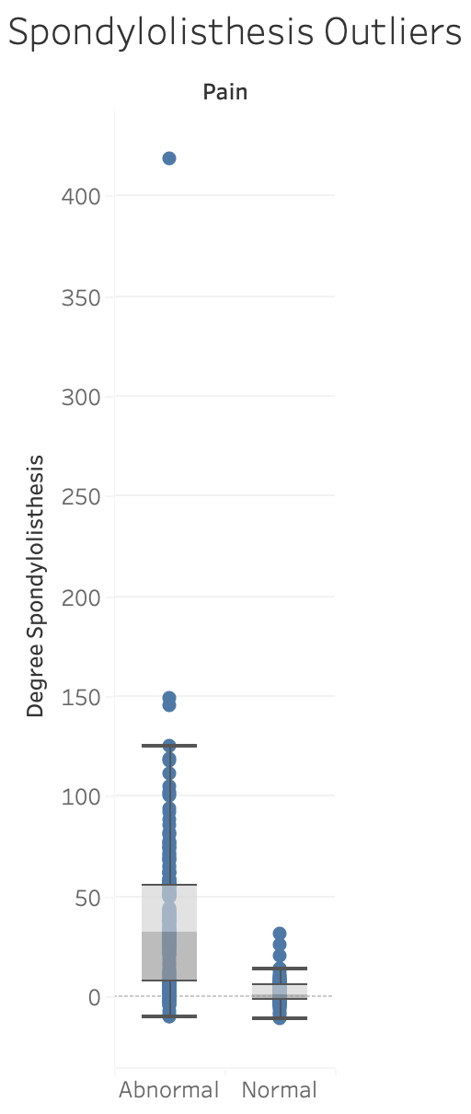

Slide 22
There seem to be a few of outliers.
It is interesting to note that the range of data for degree of spondylolisthesis for normal pain is a lot smaller than abnormal pain.
This backs up the idea that it is most likely that someone who has a significant degree of spondylolisthesis also experiences abnormal pain, since it can be such a severe condition.

Slide 23
How accurately can we predict if someone experiences lower back pain?
To answer this question, a type of unsupervised machine learning called k-Nearest Neighbors, or kNN was performed on the data.
This took the data from all 12 attributes, looked for patterns, and made a model that would predict the pain a patient experiences that presents with measurements for all 12 attributes.
The accuracy of the model was improved by determining the best numbers to use for k and comparing the accuracy results.

Slide 24

How accurately can we predict if someone experiences lower back pain?
Accuracy of the Model:
86% Abnormal Prediction Rate
66% Normal Prediction Rate
Using 11 Neighbors Provided the Best Model
This means that the model predicted abnormal pain correctly 86% of the time.
It only predicted normal pain correctly 66% of the time, it was not as accurate.

Slide 25
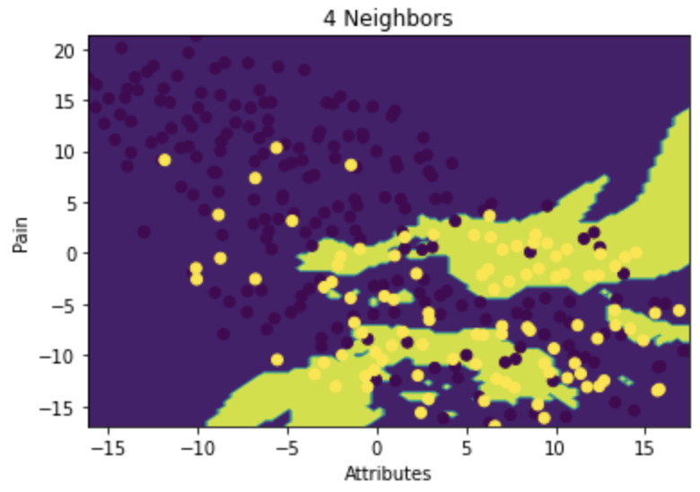
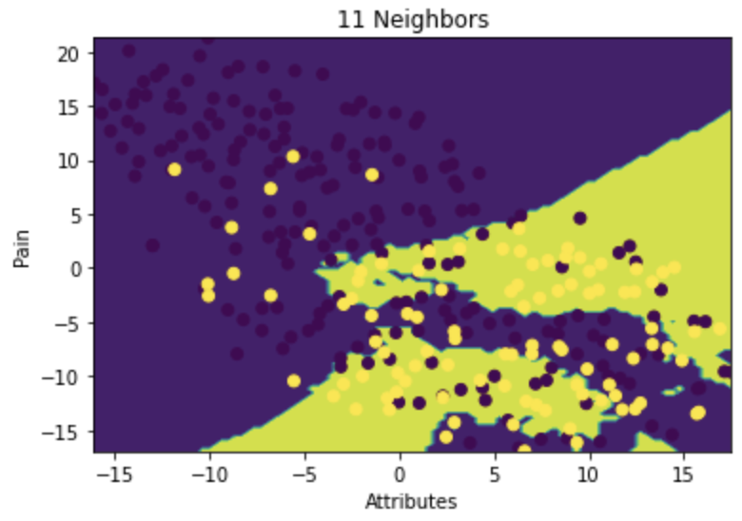
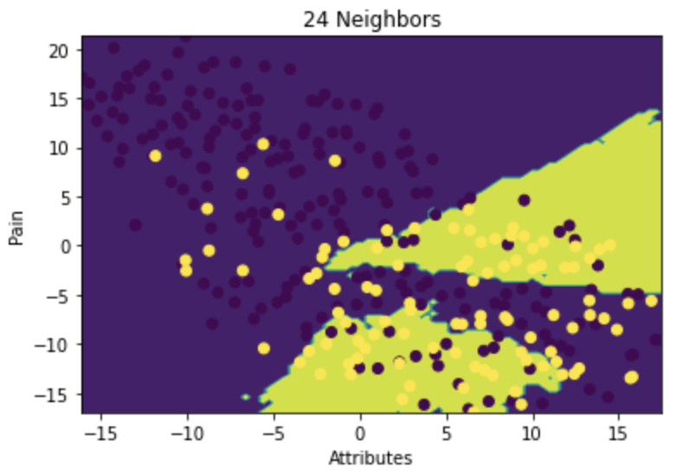
4 Neighbors Rates:
81% Abnormal Prediction Rate
69% Normal Prediction Rate
These visualizations show how the learning model clustered and predicted pain.
Purple: Normal
Green: Abnormal
Dark Purple Points: normal pain that wasn’t classified
Yellow Points: abnormal pain that wasn’t classified
11 Neighbors provided the best model, which can be seen by the amount of green. It has more green space than the other two models.
There are more dark purple points than yellow points, which corresponds with the lesser accuracy for normal vs. abnormal pain.
24 Neighbors Rates:
82% Abnormal Prediction Rate
68% Normal Prediction Rate

Slide 26
Summary
The attributes that have the greatest impact on Lower Back Pain are:
Pelvic Incidence, Pelvic Radius, Pelvic Tilt, Degree of Spondylolisthesis, and Lumbar Lordosis Angle.
Abnormal Lower Back Pain can accurately be predicted 86% of the time based on this data.

Slide 27
Conclusion
These findings show that it is possible to accurately predict whether someone experiences lower back pain based on measurements of attributes in their spine.
With additional data, such as on a scale of 1-10 how bad a person’s pain is, a more robust and accurate model could be created to indicate how severe someone’s pain is, and not just if that person is experiencing pain.
Having a diagnostic tool to help physicians better understand the pain their patient is experiencing will help them aid in the prevention, timely treatment, and effective treatment of lower back pain for their patient.

Slide 28

Questions?

